Slide 1

Catheter-Associated Urinary Tract Infections (CAUTI) Incidence Estimates Influenced by
Documentation Completeness in an
East African Regional Referral Hospital
Flavia Nakayima Miiro, MS, a-IPC,
Epidemiology PhD Candidate, University of Arizona
Email: fnmiiro@arizona.edu/flatmiiro@gmail.com

Slide 2
The Big Picture: Aims
Aim 1: To determine completeness in documentation necessary for CAUTI surveillance on adult inpatient wards the impact of completeness on incidence estimates
Aim 2: To establish adherence some CAUTI prevention bundles on the medical and surgical inpatient wards
Aim 3: To identify barriers and facilitators of CAUTI surveillance, prevention, and management using a mixed-methods approach to integrate healthcare worker perspectives
Notes:
Too wordy. Use bullets in slides, full sentences in your script. I made direct edits here.

Slide 3
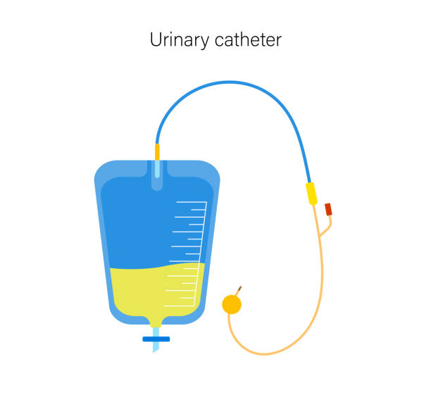
Meet Patient X, aged 62 years
Patient X - admitted with diabetic shock
A urinary catheter is inserted
Patient recovers in 4 days, so you plan to remove the catheter and discharge
WAIT!! Urine is cloudy, and the patient has a fever
You request a urine culture, antibiotic prescription – broad spectrum
It is positive
Antibiotic prescription – broad spectrum
Now the patient must stay in the hospital longer
Antibiotic prescription – narrow spectrum
Meanwhile, the ward is overcrowded, and the HCWs have one more patient to their already heavy load

Slide 4
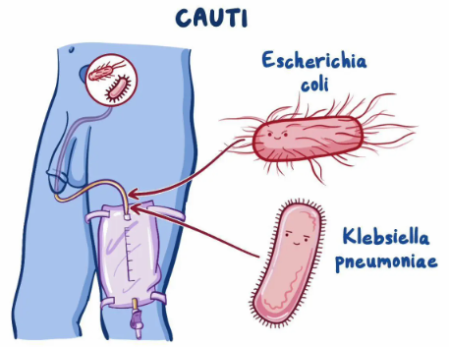
Complications with CAUTI
To the Patient
To the healthcare workers
To Public Health
Prolonged hospital stay
Risk for sepsis
Antibiotic resistance
One more patient to their already heavy load
Antibiotic stewardship efforts

Slide 5

Background: Epidemiology
CAUTI is a major public health issue:
  ~40% of healthcare-associated infections (HAIs)[1]
  Impacting antibiotic stewardship efforts.
High rate of catheterization
  1 in 4 hospitalized patients [2]
Risk Factors for CAUTIs: [3]
  1) Improper catheter insertion technique
  2) Inadequate catheter care or management
  3) Prolonged duration of catheter use

Slide 6



HAI Surveillance
Core element of infection prevention & control
(IPC)[4, 2]
Essential for measuring the success of IPC and identifying areas of improvement [4,5]

Slide 7

CAUTI Incidence
Limited monitoring in LMICs –
International Nosocomial Infection Control Consortium (INICC) conducts HAI surveillance in ICUs in 45 LMICs[7]
Higher CAUTI incidence in LMICs – 3.2 per 1,000 catheter-days in INICC vs. 1.1 per 1,000 in the USA[7, 8]
High incidence reported in single-site studies – 28 per 1000 catheter-days in Uganda, 32 per 1000 catheter-days in Kenya [9-10]

Slide 8
CAUTI Case definition
CDC/Kenya MoH | WHO | EU CDC
Has an indwelling urinary catheter for >48 consecutive hours AND One symptom documented AND Urine culture results ≤2 species | Has a urinary catheter for 2 days AND Microbiologically confirmed 1 symptom and culture positive OR Unconfirmed 2 symptoms and other tests (dipstick, pyuria with WBC) OR 3 symptoms and clinical diagnosis of UTI | Indwelling urinary catheter present (even intermittently) in the 7 days preceding the onset of infection and Symptoms present Positive culture

Slide 9
CAUTI Case definition
CDC/Kenya MoH | WHO | EU CDC
Has an indwelling urinary catheter for>48 consecutive hours AND One symptom documented AND Urine culture results ≤2 species | Has a urinary catheter for 2 days AND Microbiologically confirmed 1 symptom and culture positive OR Unconfirmed 2 symptoms and other tests (dipstick, pyuria with WBC) OR 3 symptoms and clinical diagnosis of UTI | Indwelling urinary catheter present (even intermittently) in the 7 days preceding the onset of infection and Symptoms present Positive culture

Slide 10
CAUTI Case definition
CDC/Kenya MoH | WHO | EU CDC
Has an indwelling urinary catheter for>48 consecutive hours AND One symptom documented AND Urine culture results ≤2 species | Has a urinary catheter for 2 days AND Microbiologically confirmed 1 symptom and culture positive OR Unconfirmed 2 symptoms and other tests (dipstick, pyuria with WBC) OR 3 symptoms and clinical diagnosis of UTI | Indwelling urinary catheter present (even intermittently) in the 7 days preceding the onset of infection AND Symptoms present Positive culture

Slide 11



CAUTI incidence calculation
Numerator = number of CAUTIs (Must have a Positive culture (microbiology) and CAUTI symptoms documented)
Denominator = Urinary catheter-days
CAUTI rate = $\frac{\# CAUTIs identified}{Urinary catheter days} x 1000$

Slide 12

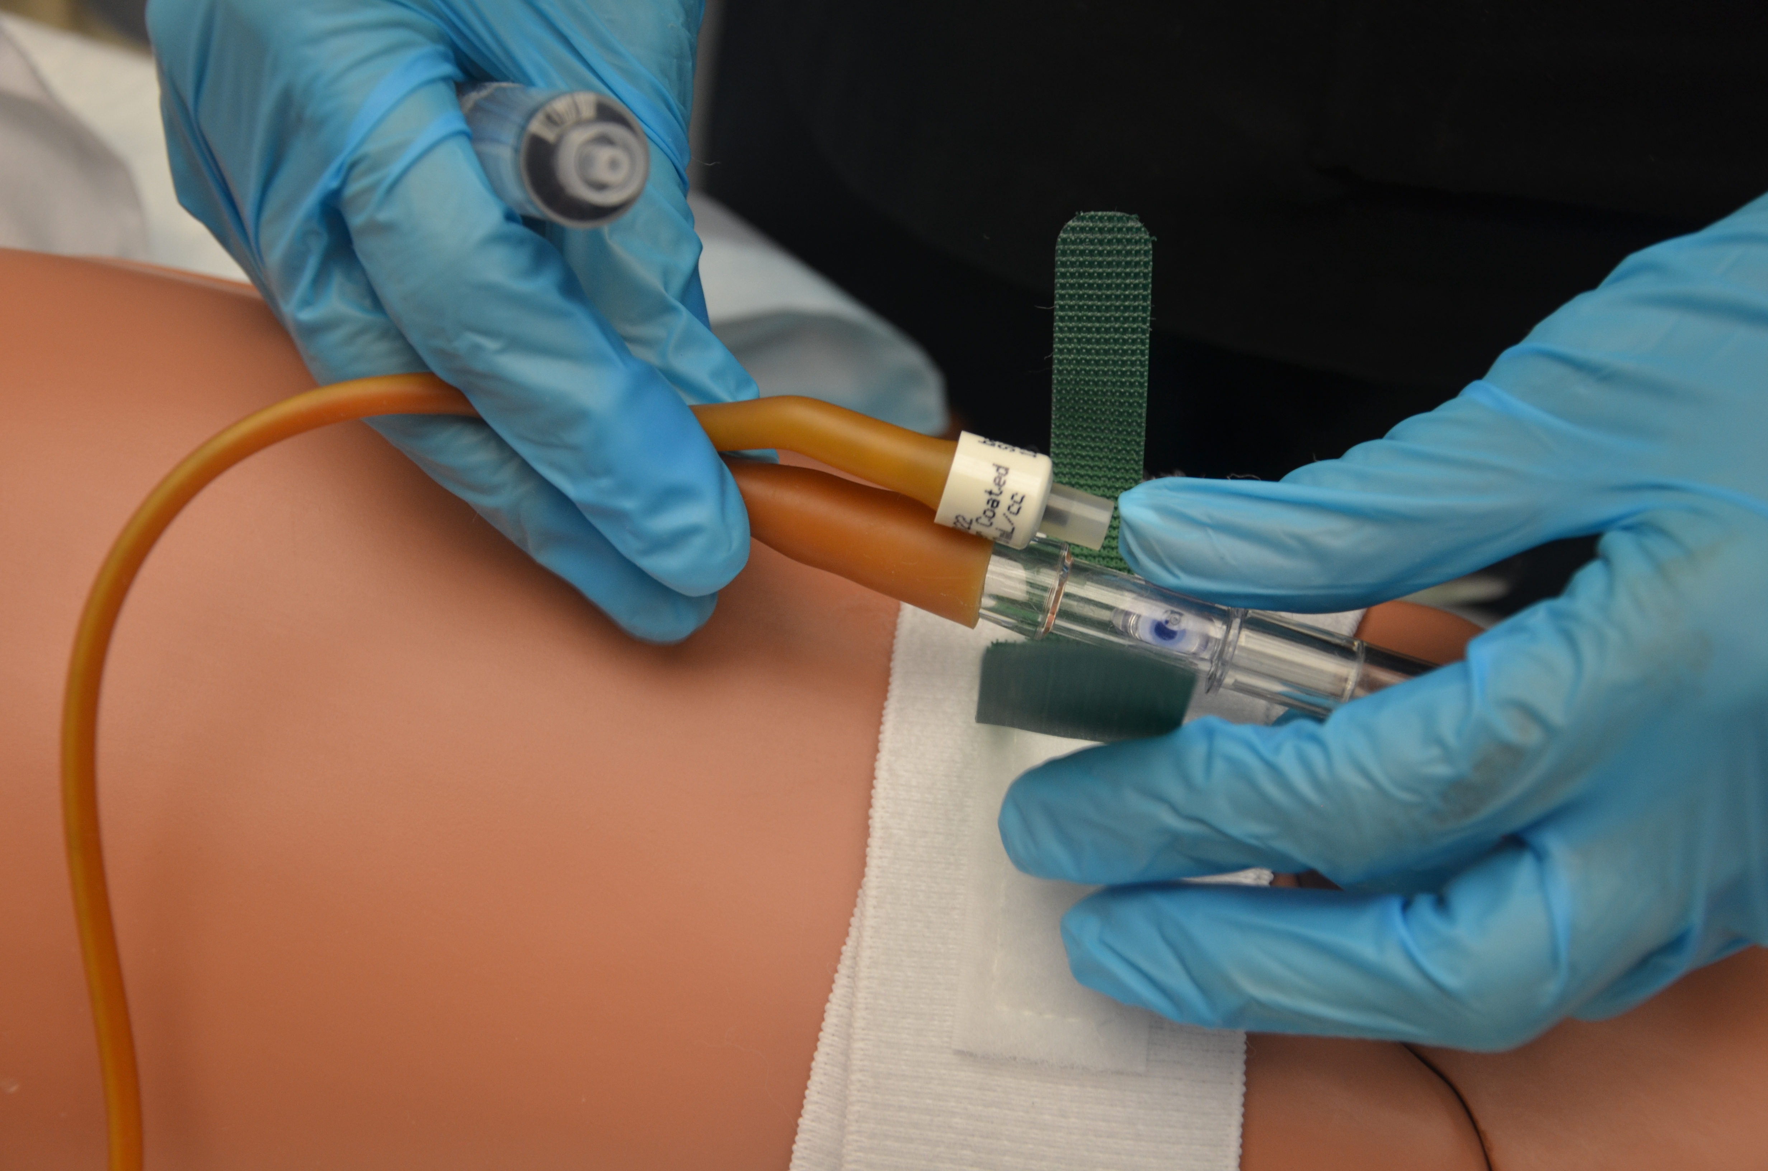
Justifications for
Relaxing Definitions
Missing and inconsistent documentation of symptoms
  Use antibiotic initiation of UTI-specific ABX as a proxy
    (clinically defined CAUTI)[11]
Undocumented catheter removal dates
  Use discharge date
Inclusion of all population in the calculation
Missing/inconsistent definitions has led to relaxing of certain documentation components like symptoms

Slide 13


Research aims
Aim 1:
Assess the completeness of documentation in patient charts needed to meet the CAUTI case definition
Aim 2:
Evaluate the impact of documentation gaps on estimated CAUTI incidence by applying modified case definitions.

Slide 14
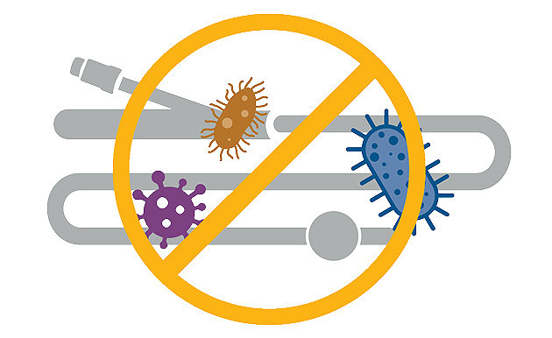
METHODS

Slide 15
Methods
Retrospective medical chart review covering medical records from Jan 1 to Dec 31, 2023
Ethical approval: AMREF IRC, NACOSTI, UA IRB, and CGTRH scientific committee

Slide 16


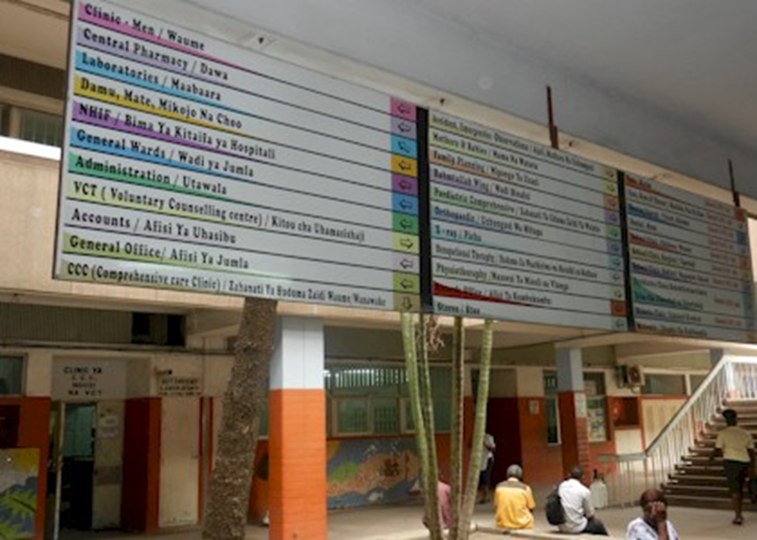

Study Setting
Coast General Teaching & Referral Hospital
Mombasa, Kenya
  739-bed hospital
  Level 5 Hospital

Slide 17




Inclusion criteria
Adults
Inpatients
Urine culture request (Suspect UTI)
Indwelling urinary catheter

Slide 18
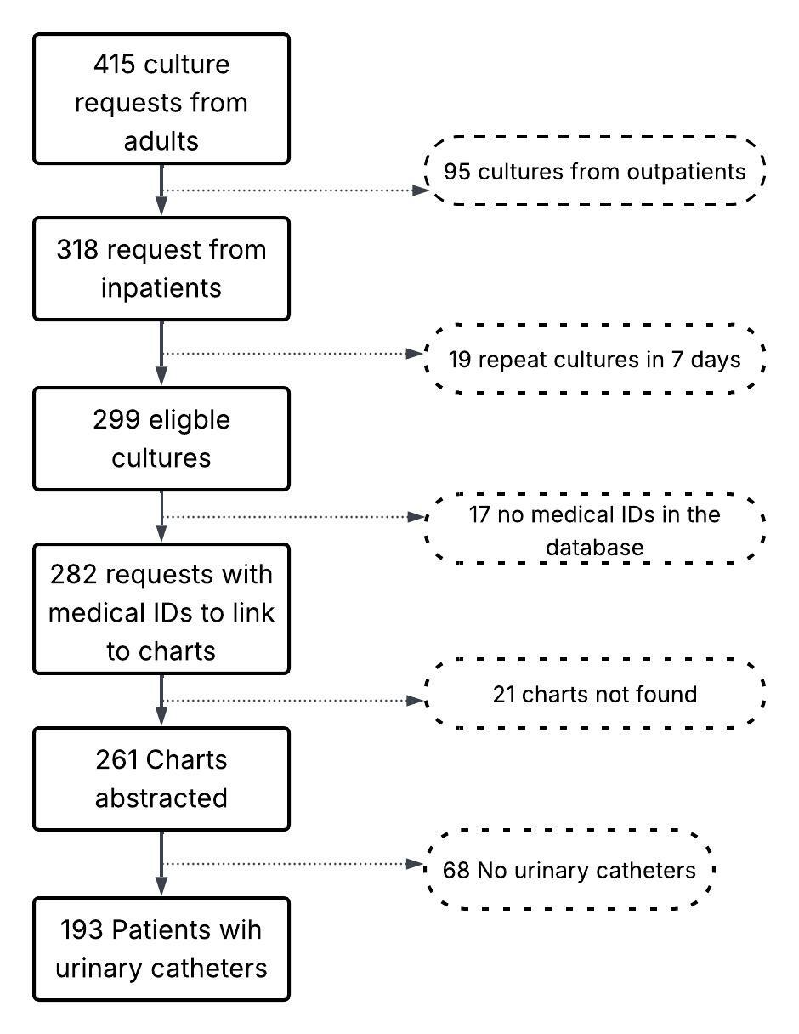

Sample size
Jan 1 through Dec 31, 2023.
193

Slide 19
Variables
Outcome
  Documentation of UTI symptoms
  Documentation of microbiology results
  Documentation of catheter insertion and removal dates
Predictors
  Ward of admission
  Length of hospitalization
  Catheter-related information – reason for catheterization, cadre inserting, place of insertion, and type of catheter

Slide 20


Data Abstraction
193 paper records reviewed
Variables extracted
  Patient demographics
    Age
    Sex
    Ward of admission
    Adm diagnosis and comorbidities
  UTI symptoms
  Urine culture results
  Catheter use
    Indication
    Dates insertion/removal
    Catheter type, place, cadre
  Antibiotic prescription

Slide 21
Data analysis – Aim 1
Descriptive statistics
  Using
    Percentages for discrete data
    Median for continuous data
  Describe other factors related to
    Hospitalization
    Catheterization
  Establish the documentation completeness in the patient charts:
    Documentation of
      1) symptoms before urine culture request
      2) urine culture results
      3) catheter insertion and removal dates
  Predictors of completeness

Slide 22
Data analysis Aim 2
Calculation of CAUTI incidence
Establish the 95% confidence intervals
CAUTI rate =$\frac{\# CAUTIs identified}{Urinary catheter days} x 1000$
95% confidence interval = $\frac{\#CAUTI events±1.96\sqrt{\#CAUTIs}}{catheter−days}$ $x 1000$

Slide 23


CAUTI incidence criteria
CDC/MoH – Documentation of 1 symptom, culture results, and catheter dates (STRICT)
Relaxing Numerator – UTI antibiotic prescription used as a proxy for clinical infection
Relax Denominator – Discharge date is used as the catheter removal date
Relax Numerator and Denominator

Slide 24
RESULTS

Slide 25



Who is included in the sample? N=193
Age
Sex
Ward of admission
Male
50.3%
Female 49.7%
18 51 89
Non-ICU: 81%
ICU: 19%

Slide 26
Descriptive statistics (N=193)
 | n (%)
Ward of admission ICU Medical Surgical Obstetrics & Gynecology | 36 (18.6) 126 (65.3) 25 (12.9) 6 (3.1)
Length of hospitalization over 15 days | 111 (57.5)
Antibiotics prescribed within 7 days before the culture | 98 (58.3)

Slide 27
Descriptive statistics…
Catheter-related variables | n (%)
Indications for catheterization are documented | 162 (83.9)
Type of catheter inserted indicated | 34 (17.6)
Place of catheter insertion indicated | 126 (65.3)
Cadre inserted the catheter documented | 24 (12.4)

Slide 28
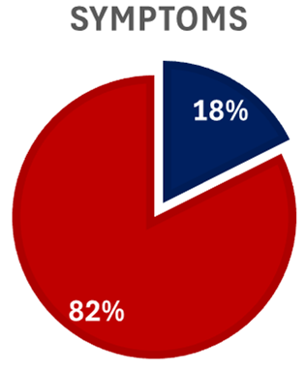
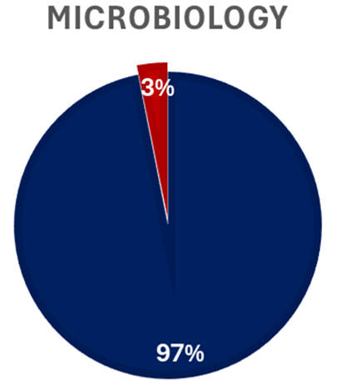
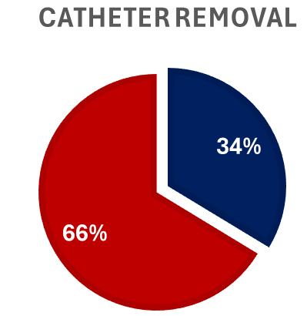

Documentation status

Slide 29

CAUTI Incidence Calculation
Culture results | UTI symptoms | Catheter documentation |  | Sample size | Numerator | Denominator
 |  | Insertion | Removal
 |  |  |  | 19 | 11 | 399
 | Relaxed (ABX prescription as proxy) |  |  | 41 | 17 | 471
 |  |  | Use the discharge date if missing | 34 | 21 | 818
 | Relaxed (assume all had symptoms) |  | Use the discharge date if missing | 193 | 59 | 3971

Slide 30
CAUTI Incidence
Case definition | Incidence/ 1000 catheter-days | 95% Confidence intervals
CDC/MoH | 27.6 | 13.8 – 49.3
Relaxed denominator | 25.7 | 15.9 – 39.2
Relaxed numerator | 36.1 | 21.0 – 57.8
Relaxed numerator and denominator | 14.9 | 11.3 – 19.2

Slide 31
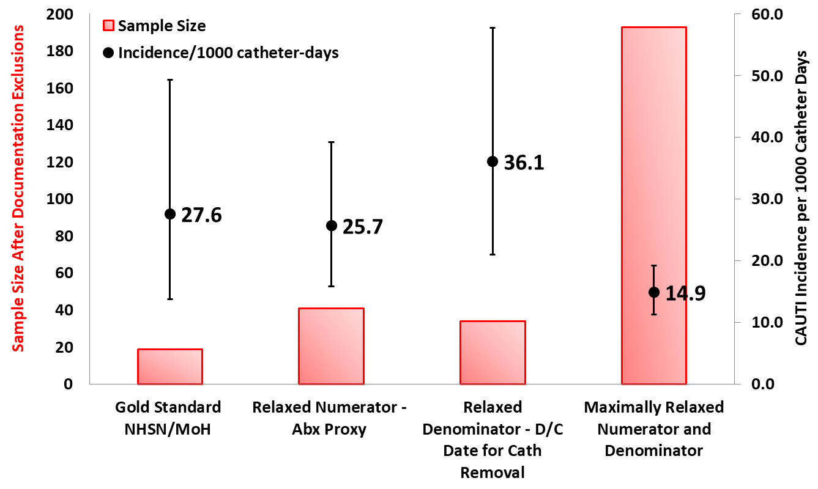
Sample Size & Incidence by Definition
N=41
(471 Cath Days)
N=193
(3971 Cath Days)
N=34
(818 Cath Days)
N=19
(399 Cath Days)

Slide 32

Summary of Findings
AIM 1:
Documentation gaps are similar in ICU and non-ICU
97% had microbiology results documented in the chart
Only 18% had symptoms documented
34% had catheter removal documented

Slide 33
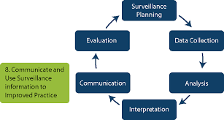
Summary of Findings
AIM 2:
Only 9.8% (19) could satisfy the CAUTI MoH criteria
High CAUTI incidence even when the criteria are relaxed

Slide 34
Pros and cons of the different scenario
Relaxed criteria
Pros
  More inclusive to take in a bigger sample size
Cons
  Reduced comparability
  No guide to antibiotic stewardship and resource allocation
  Infection prevention efforts affected
Gold standard
Pros
  Comparable findings with other countries/regions
Cons
  Excludes the biggest sample size

Slide 35
Conclusions
Whereas laboratory capacity has been cited in literature as a key hindrance to surveillance, lab capacity is not a key issue here [11]
CAUTI incidence rates are affected by documentation gaps
Incidence rates may not be comparable with other hospitals.
With the antibiotic prescription, all of the estimates are likely underestimated because 60% of suspect UTI were prescribed antibiotics w/in 7d so there may be false negatives on the microbiology.

Slide 36
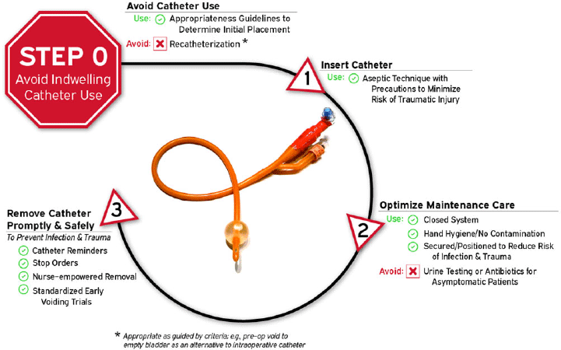
Recommendations
A CAUTI surveillance protocol is needed to guide practice and ensure standardization
Active documentation of the CAUTI case definition on the same sheet enables surveillance

Slide 37
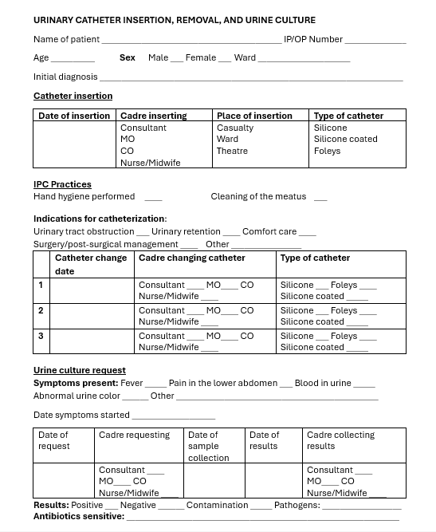
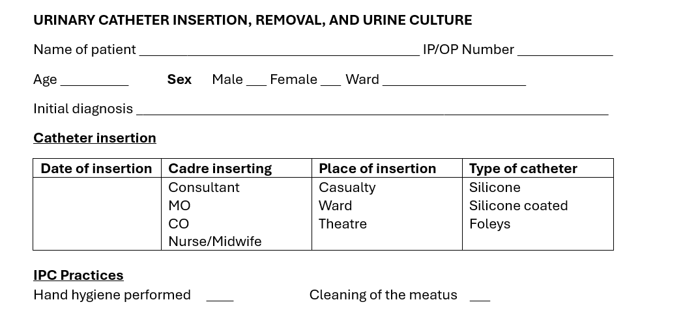
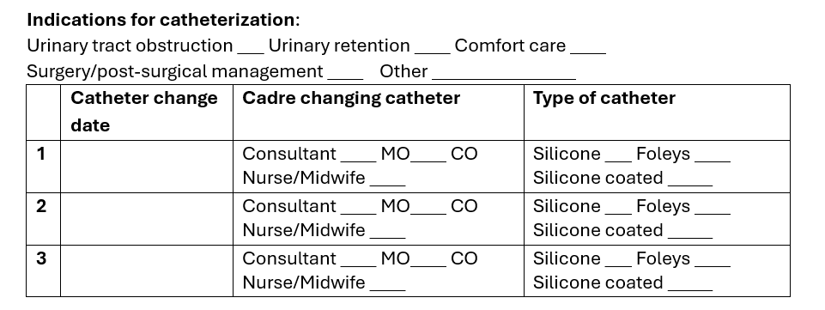
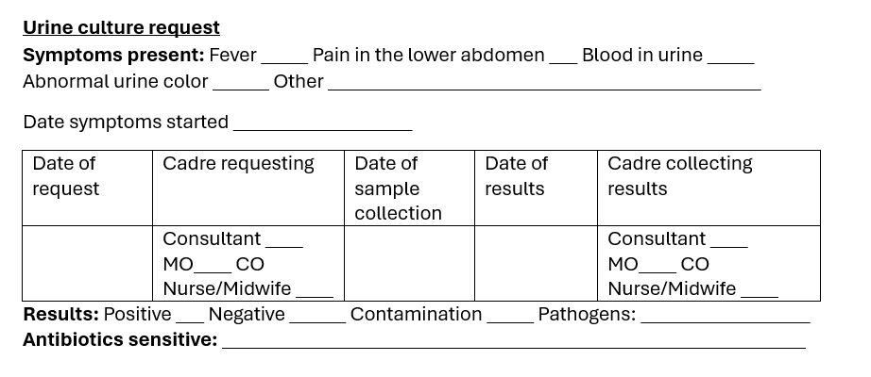

Slide 38



Acknowledgements
Doctoral committee
Academic advisor – Dr Kate Ellingson
In-country mentor – Dr Linus Ndegwa
Hospital Collaborator – Dr Irene Muramba
The Ellingson Lab
My Doctoral cohort

Slide 39
References
Venkataraman, R. and U. Yadav, Catheter-associated urinary tract infection: an overview. Journal of Basic and Clinical Physiology and Pharmacology, 2023. 34(1): p. 5-10
Lewis, S.S., et al., Comparison of non-intensive care unit (ICU) versus ICU rates of catheter-associated urinary tract infection in community hospitals. Infect Control Hosp Epidemiol, 2013. 34(7): p. 744-7.
(CDC), C.f.D.C.a.P. Healthcare-Associated infections (HAIs). Catheter-associated Infections (CAUTI) October 16, 2015 [cited 2024 April 24]; Available from: https://www.cdc.gov/hai/ca_uti/uti.html.
(WHO), W.H.O., Guidelines on Core Components of Infection Prevention and Control Programmes at the National and Acute Health Care Facility Level. 2016. 91.
(MoH), M.o.H., Kenya National Infection Prevention and Control Policy for Health Care Services. 2021, Government of Kenya: Nairobi, Kenya. p. 3-7, & 15.
Rosenthal, V.D., et al., International Nosocomial Infection Control Consortium (INICC) report, data summary of 45 countries for 2013-2018, Adult and Pediatric Units, Device-associated Module. American Journal of Infection Control, 2021. 49(10): p. 1267-1274.
Meddings, J., et al., Multistate programme to reduce catheter-associated infections in intensive care units with elevated infection rates. BMJ Qual Saf, 2020. 29(5): p. 418-429.
Oumer, Y., et al., Catheter-Associated Urinary Tract Infection: Incidence, Associated Factors and Drug Resistance Patterns of Bacterial Isolates in Southern Ethiopia. Infect Drug Resist, 2021. 14: p. 2883-2894.
Ndomba, A.L.M., et al., Urinary Tract Infections and Associated Factors among Patients with Indwelling Urinary Catheters Attending Bugando Medical Centre a Tertiary Hospital in Northwestern Tanzania. Microorganisms, 2022. 10(2): p. 473.
1Etyang, C., G. Nambozi, and L. Brennaman, A Nurse-Led Low-Cost Intervention Effectively Traces Prevalence of Catheter Associated Urinary Tract Infections at a Low-Resourced Regional Referral Hospital in Western Uganda: A Case for Policy Change. Policy, Politics, & Nursing Practice, 2020. 21(1): p. 4-11.
Mwanja, H., et al., Utility of syndromic surveillance for the surveillance of healthcare-associated infections in resource-limited settings: a narrative review. Front Microbiol, 2024. 15: p. 1493511
Verberk, J.D.M., et al., Automated surveillance systems for healthcare-associated infections: results from a European survey and experiences from real-life utilization. J Hosp Infect, 2022. 122: p. 35-43..

Slide 40

Thank you

